Slide 1


Alzheimer's early risk assessment
Zow Ormazabal
Copyright ©2024 TAO Digital - All rights reserved.

Slide 2
Outline
Project overview
Problems and challenges
Current solutions and our solution
Architecture details
Dataset overview
User journey and demo
Results and Cost
Conclusion
Notes:
Here's a quick overview of what we'll cover: the problems this tool addresses, the five-step pipeline that powers it, a demo of the Streamlit interface, the evaluation results, and a look at cost and next steps.

Slide 3
Alzheimer's Early Risk Triage - Overview
Overview
Client value
A screening pipeline for Alzheimer's risk screening. It takes cognitive scores + demographics and returns an Alzheimer's risk score with the top contributing factors, before imaging is ordered. MRI-based severity classification and EEG-based confirmation each add an independent signal, fused into one integrated prognosis, with an LLM decision-support layer (doctor summary, grounded Q&A, live evidence retrieval) on top.
Every unnecessary MRI or PET scan is money and scanner time the client can't get back, and every Alzheimer's case caught late is a patient the health system could have helped sooner. This closes that gap: it scores Alzheimer's risk from data the clinic already has on file, days before anyone books a scan, and hands the clinician a second and third opinion (MRI, EEG) plus an AI-drafted case summary the moment those results come in.
Key Objective
Flag at-risk patients early from data clinics already collect, so imaging and specialist time are spent where they matter.
Category
Clinical / digital-health machine learning
Notes:
Let me orient you to what we built and what data it runs on.
>
> The agent's central question is not 'should we contact this patient?' -- it is 'which specific intervention, if any, actually changes this patient's behavior?' For a forgetful young patient, the answer is a reminder call. For a patient with high side-effect burden, it is an HCP check-in. For a well-adherent, engaged patient, the answer is no contact at all. Sending the wrong intervention is not neutral -- it erodes trust and burns the patient's attention.
>
> Four data assets make this possible. The epilepsy care plan JSON is the clinical ground truth: it tells the system what medications this patient is on, when doses are scheduled, what counts as an emergency, and who to call. Every LLM reply is grounded in this file -- the model cannot invent instructions that contradict it.
>
> The synthetic panel of 500 patients trains the causal model. Each row is a patient with a profile -- age, adherence history, side-effect burden, engagement level -- assigned to one intervention arm, with a recorded outcome. The T-learner learns from this panel which features predict a response to each arm.
>
> The DuckDB dose-event log is the real-time feed. It records every dose taken or missed over 28 days and surfaces the metrics that drive both the LLM context and the intervention recommendation: 30-day adherence rate, 7-day trend, and current missed-dose streak.
>
> And the Qini backtest data is the evidence layer. It shows that the model identifies the right patients four times more effectively than random outreach -- an AUUC of 0.35 against a random baseline of 0.08. We will return to that number later, but it is the single most important validation result in the project.
>
> The next few slides walk through each problem this architecture addresses, then how the pipeline runs end to end.

Slide 4
Problems and Challenges
Problems
Challenges
Imaging is the most expensive, most capacity-constrained step in the diagnostic path, every scan ordered without prior evidence is a scan that could have gone to a higher-priority patient.
Diagnosis usually happens after symptoms are already visible. The data that could have flagged risk earlier is sitting unused in the chart.
Existing risk tools are black boxes, which makes clinicians reluctant to act on them and makes them hard to certify and integrate across a product line.
Target leakage: the clinical dementia rating (CDR) is not a predictor of diagnosis, it is the diagnosis. Some ML approaches have this label leakage.
Data availability: Comprehensive medical datasets are hard to obtain due to privacy issues.
Rare to find paired training data for data fusion.
Notes:
"Why are we building this? Researchers and clinical operations teams face four compounding problems.
>
> First, notification fatigue. When every patient gets a reminder regardless of need, engagement collapses. Second, patient needs are heterogeneous -- a forgetful young patient needs a reminder; a patient on multiple AEDs with worsening side effects needs an HCP call. The same tool cannot serve both.
>
> Third, and most critically for clinical AI, LLMs cannot own safety decisions. If a patient reports a seizure lasting ten minutes, that must trigger a 911 instruction -- no matter what the model thinks the 'right tone' is. Fourth, most adherence analytics use correlation, not causation: we need to know what *changes* outcomes, not just who is already adherent. And fifth, any tool that will touch patient workflows must be defensible to regulators and HCPs."

Slide 5
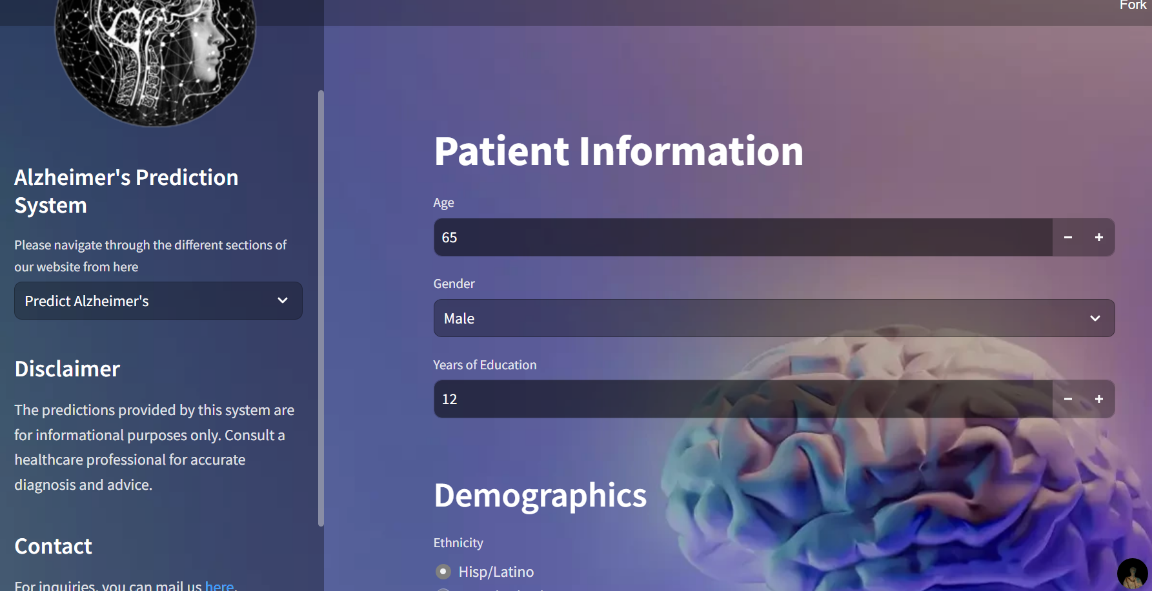
Current solutions: Arpy8's Streamlit app

Slide 6
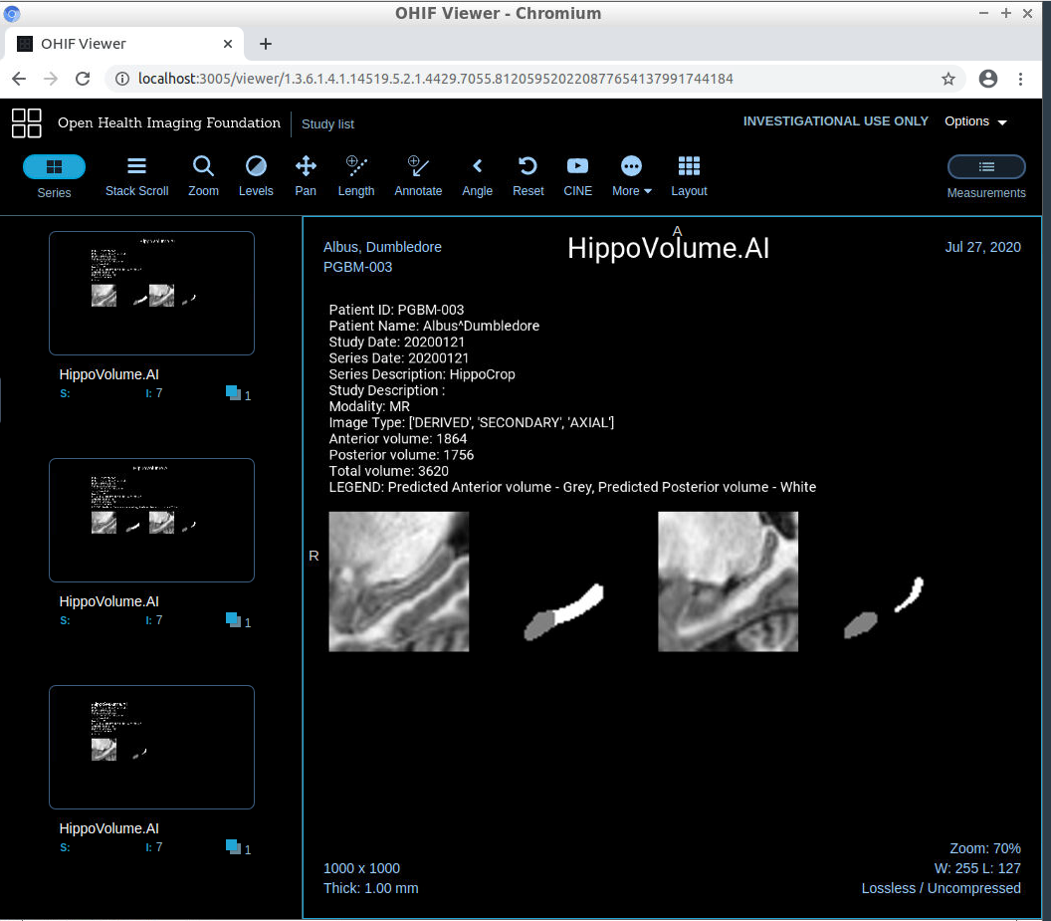
HippoVolume.AI: Predicts the risk of Alzheimer's based on hippocampal volume
Notes:
https://github.com/pranath/predict_alzheimers

Slide 7
Our solution
A single risk score, confirmed by imaging and EEG when needed, explained in plain language, reachable from anywhere with one function call. We avoid extra costly steps.
Features:
Every risk score ships with its top 3 reasons in plain language ("raises/lowers risk"), because a number clinicians can't interrogate is a number they won't act on.
A second opinion from imaging: when a scan exists, the system classifies dementia severity from the MRI itself and highlights the exact regions that drove the call: confirmation a clinician can visually check, not just take on faith.
One prognosis, not three conflicting numbers: clinical, MRI, and EEG signals are fused into a single score that based on whichever modality is most confident
An AI layer that does the busywork a clinician shouldn't have to: an automatic case summary, plain-language MRI findings, free-form Q&A on the case, and live pulls from PubMed and ClinicalTrials.gov with citations.
Notes:
Step 1, top-left: the patient opens the chat interface and types something like 'I'm not feeling great, I missed my last dose.' They can also tap a quick-reply button. That message immediately enters the pipeline.
Step 2: before any language model touches it, a deterministic rule engine runs. No LLM, no probabilities -- pure regex and hard-coded logic. It stamps the message with a triage badge -- here, 'Flagged' -- and generates a prescribed actions checklist: contact HCP immediately, stop medication X, seek emergency care. That checklist is fixed. The LLM cannot override it.
Step 3: only now does the LLM respond. It writes an empathetic, concise reply -- but the triage constraint is baked in as a system instruction. Notice the reply explicitly references the Flagged status and tells the patient to contact their HCP. The model cannot tell a Flagged patient to 'wait and see.'
That triggers the clinician lane. Step 4: the provider sees the alert on their dashboard alongside adherence metrics -- 30-day rate, missed-dose streak. Context before action.
Step 5: the clinician can adjust feature sliders -- side-effect score, adherence rate -- to explore scenarios and stress-test what the model recommends under different patient conditions.
Step 6: the T-learner runs. It estimates a causal treatment effect for each intervention arm -- reminder call, education message, HCP check-in, peer support -- and surfaces a ranked recommendation table in real time. Here, HCP Check-in shows the highest uplift, so it gets the asterisk. If all CATEs were negative, the system would recommend no contact.
Step 7: the clinician downloads the escalation brief -- a markdown report with the triage summary and regulatory disclaimer, ready for the audit trail.
The three value pillars at the bottom capture what this delivers: deterministic patient guardrails, personalized clinician insight, and transparent audit artifacts."

Slide 8
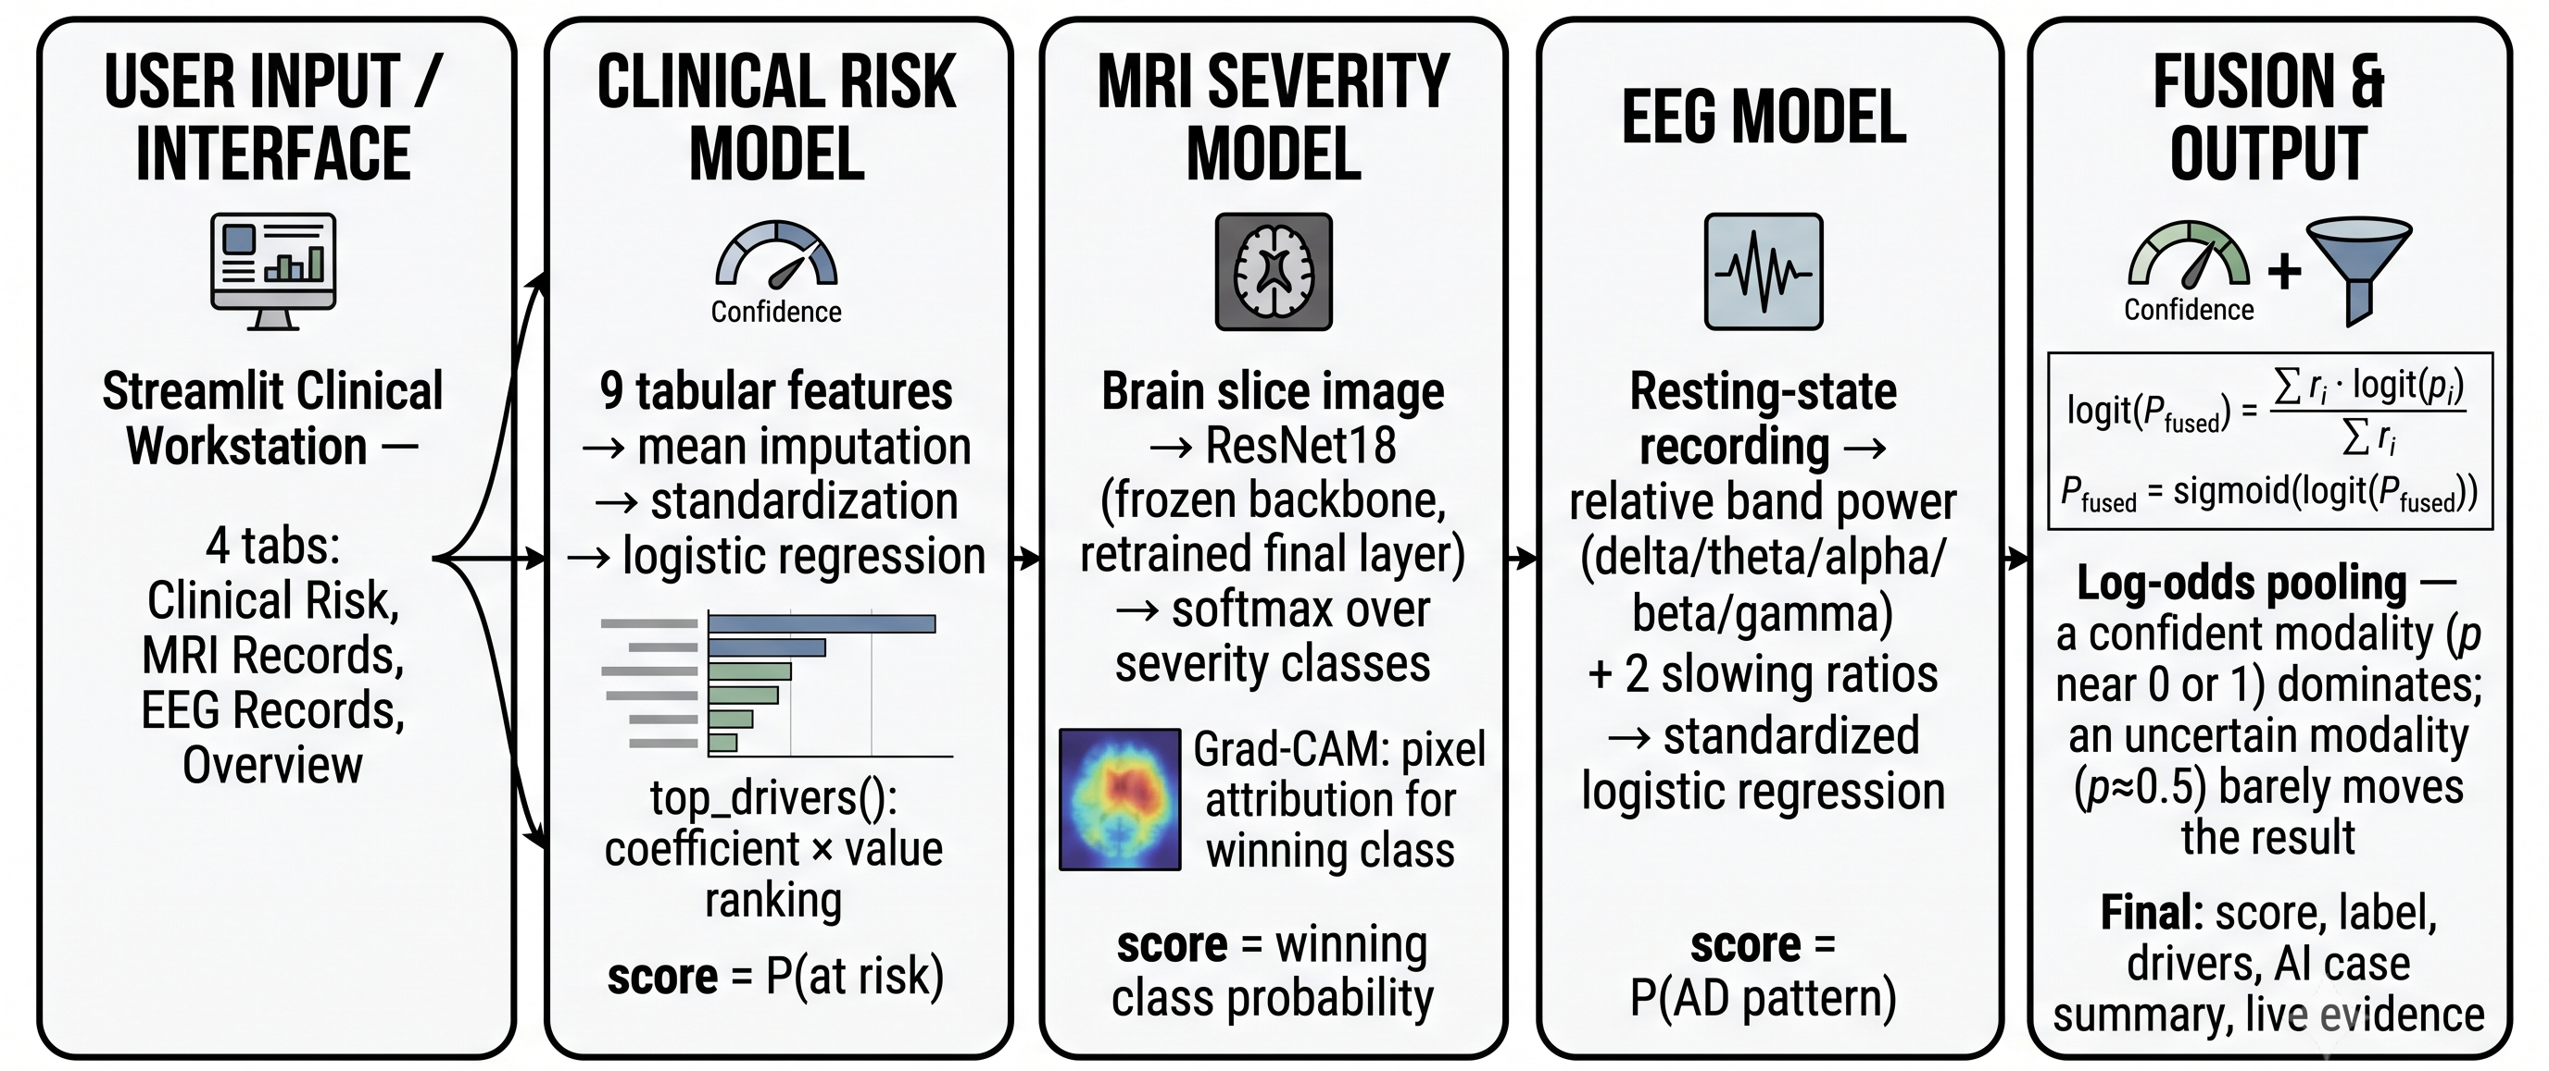
How the System Works – Overview
Notes:
> "Here is the system architecture. Three clean layers.
>
> At the top, the Streamlit frontend exposes two interfaces: the Patient Chat for real-time check-ins, and the HCP Dashboard for adherence monitoring and uplift exploration.
>
> In the middle, the backend runs five sequential steps per check-in. Notice that the triage step is completely separate from the LLM step and always runs first. The LLM cannot see the triage code; it only receives the result as a system constraint.
>
> At the bottom, four resources power the pipeline: a local DuckDB dose-event log, the LLM provider API, the trained T-learner on the synthetic patient panel, and the epilepsy care plan JSON.
>
> The worked example on this slide traces a real demo interaction. A missed-dose message triggers FLAG triage, a grounded LLM reply, and in the HCP Dashboard, the T-learner recommends an HCP check-in -- the only arm whose confidence interval lies entirely above zero."

Slide 9
Data Overview
Data source | Contains
OASIS longitudinal | OASIS-2-shaped sample: Subject ID, MRI ID, Group, Visit, MR Delay, M/F, Hand, Age, EDUC, SES, MMSE, CDR, eTIV, nWBV, ASF
OASIS-2 imaging | Nondemented/Mild/Severe Demented 2D images
EEG | Ds004504 from OpenNeuro​
Notes:
Six data assets power this system. Let me walk through what each one does and why it was built the way it was.
>
> The epilepsy care plan JSON is the clinical constitution for the LLM. It encodes levetiracetam and lamotrigine dosing, the HCP contact, and the quick-reply templates the UI exposes. When the LLM generates a check-in reply, it is working inside the boundaries this file defines -- it cannot invent a dose, contradict a schedule, or recommend something the care plan does not authorize.
>
> The synthetic patient panel is the training data for the T-learner. Five hundred patients, 100 per intervention arm. The important design decision here is that the ground-truth treatment effects are hand-coded into the data-generating function -- HCP check-in uplift scales with side-effect score, reminder-call uplift scales with non-adherence and low engagement. This is intentional: it gives us a known answer to check the model against. We are not hoping the T-learner finds a signal; we built the signal in and can verify the model recovers it.
>
> The DuckDB adherence log is the real-time data layer. Every dose event -- taken or missed, medication, timestamp -- is stored here. In this POC it is seeded at startup with 28 days of synthetic history at roughly 85% adherence. In production, this table would be replaced by an OMOP CDM or a live FHIR feed from an EHR. The rest of the pipeline does not need to change.
>
> The Qini backtest data comes from running the T-learner on a separate 500-patient holdout -- not the training set -- and scoring the ranked contact curve against random. This is where the 0.35 versus 0.08 AUUC result comes from.
>
> The Cleanlab audit is a data quality check on the synthetic panel itself. Label noise is a known risk in stochastic data generators: an outcome might be recorded as zero for a patient whose features strongly predict a positive response. Cleanlab finds those rows using cross-validated random forest probabilities. The audit confirmed that label noise is within expected bounds -- so the T-learner is not fighting corrupted training signal.

Slide 10
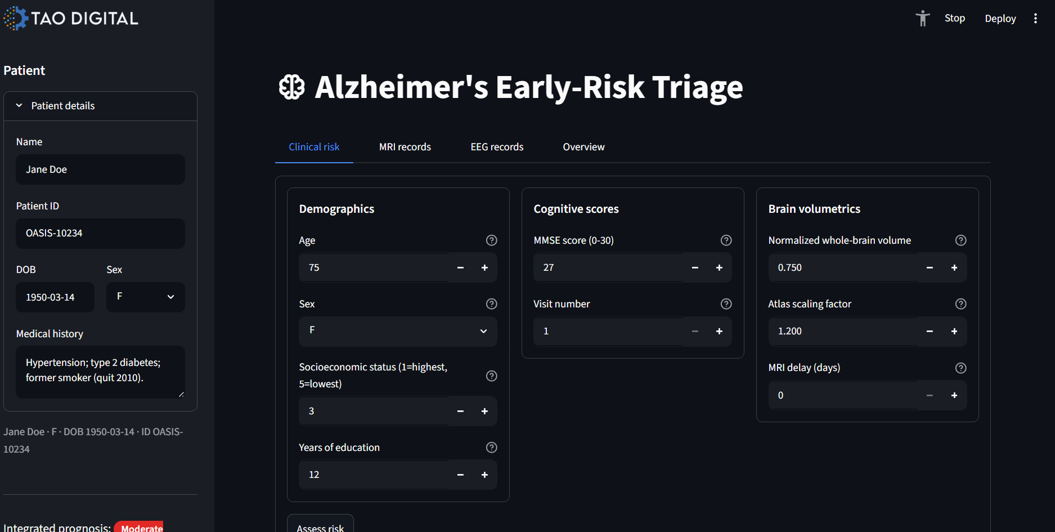
User journey
Notes:
Let's start with the most common patient scenario: a missed dose.
>
> I'll tap the quick-message button -- these are care-plan-specific pre-built messages, pulled directly from the epilepsy JSON. They cover the typical reasons a patient opens the app.
>
> Watch what happens when the message submits. The first thing the system does is run **safety triage** -- a deterministic, regex-based classifier that operates with zero LLM involvement. It does not need an API key. It does not need a network connection.
>
> Here is the result: a **FLAG badge** in yellow. That means the triage engine detected a missed-dose pattern and set `hcp_alert = True`. The prescribed patient actions appear immediately -- 'Contact your neurologist before taking extra medication. Do NOT double your dose.'
>
> Below that is the LLM reply: empathetic, concise, grounded in Keppra specifically -- not generic advice. Notice the triage level is confirmed in the LLM output. Even if the model wanted to say 'it's probably fine, wait and see', it cannot -- the triage level is injected as a hard system constraint the model must echo.
>
> At the bottom of the page, a warning banner confirms: 'FLAG -- Care team notified of missed dose.'"

Slide 11
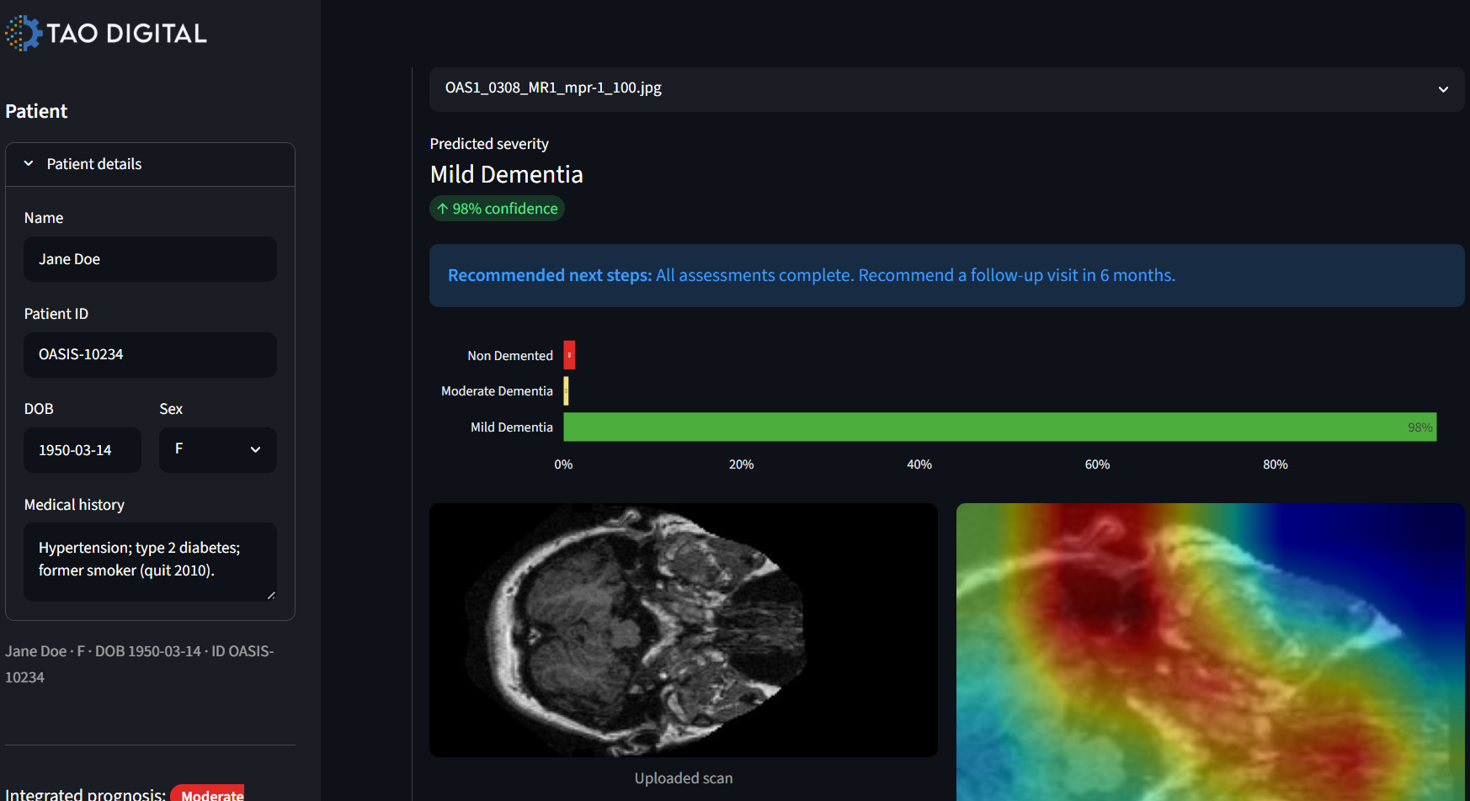
User journey
Notes:
Let's start with the most common patient scenario: a missed dose.
>
> I'll tap the quick-message button -- these are care-plan-specific pre-built messages, pulled directly from the epilepsy JSON. They cover the typical reasons a patient opens the app.
>
> Watch what happens when the message submits. The first thing the system does is run **safety triage** -- a deterministic, regex-based classifier that operates with zero LLM involvement. It does not need an API key. It does not need a network connection.
>
> Here is the result: a **FLAG badge** in yellow. That means the triage engine detected a missed-dose pattern and set `hcp_alert = True`. The prescribed patient actions appear immediately -- 'Contact your neurologist before taking extra medication. Do NOT double your dose.'
>
> Below that is the LLM reply: empathetic, concise, grounded in Keppra specifically -- not generic advice. Notice the triage level is confirmed in the LLM output. Even if the model wanted to say 'it's probably fine, wait and see', it cannot -- the triage level is injected as a hard system constraint the model must echo.
>
> At the bottom of the page, a warning banner confirms: 'FLAG -- Care team notified of missed dose.'"

Slide 12
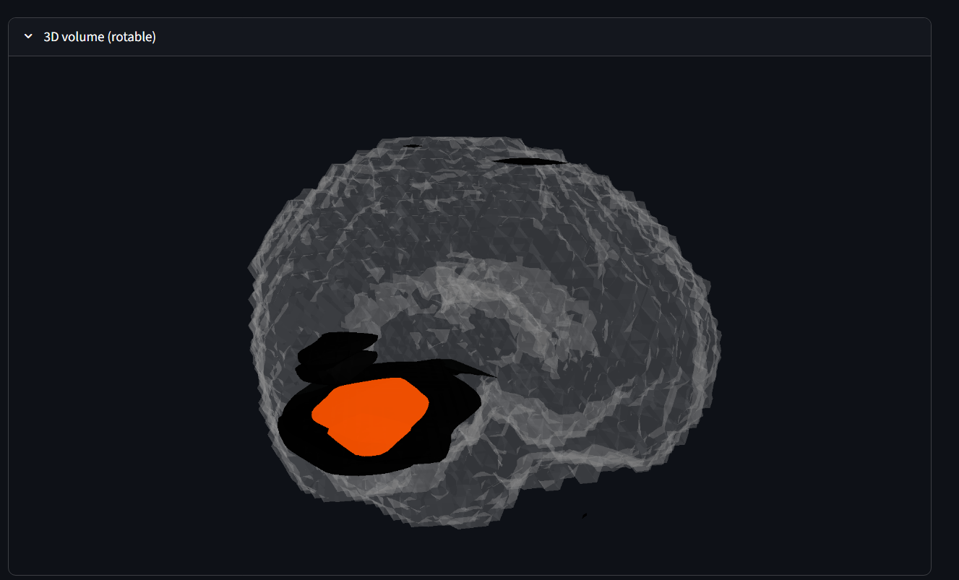
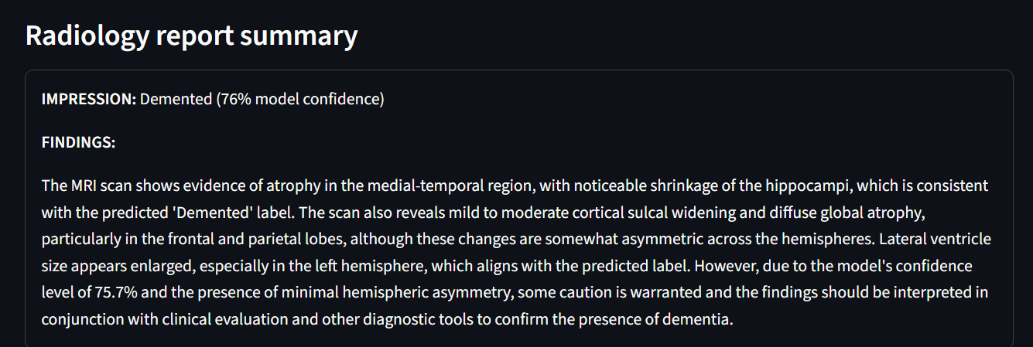

Slide 13
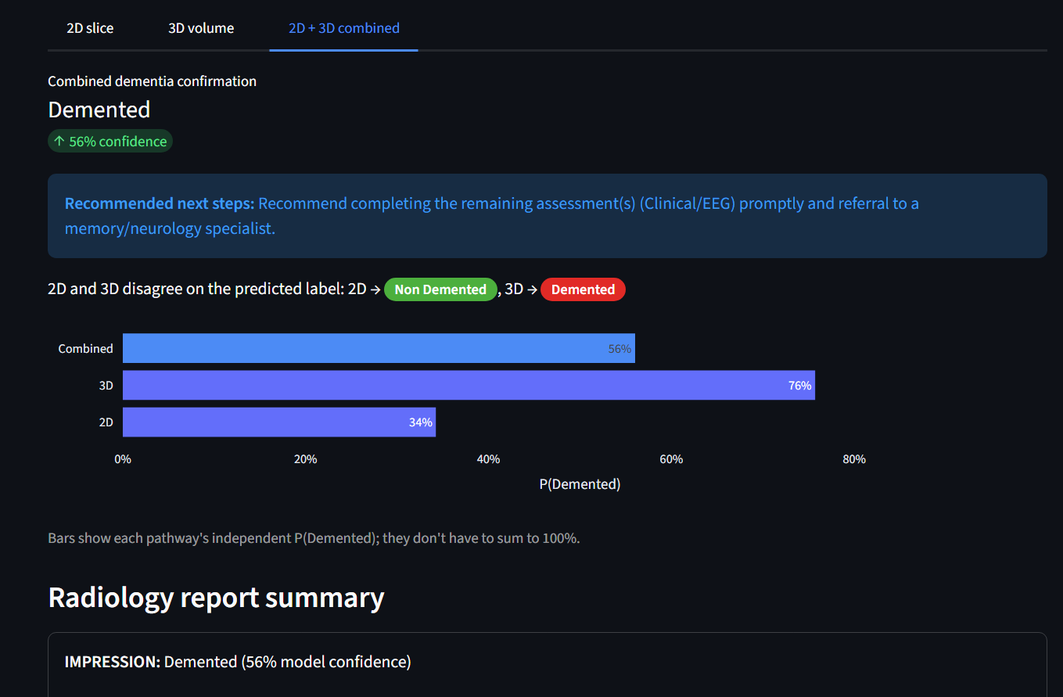

Slide 14
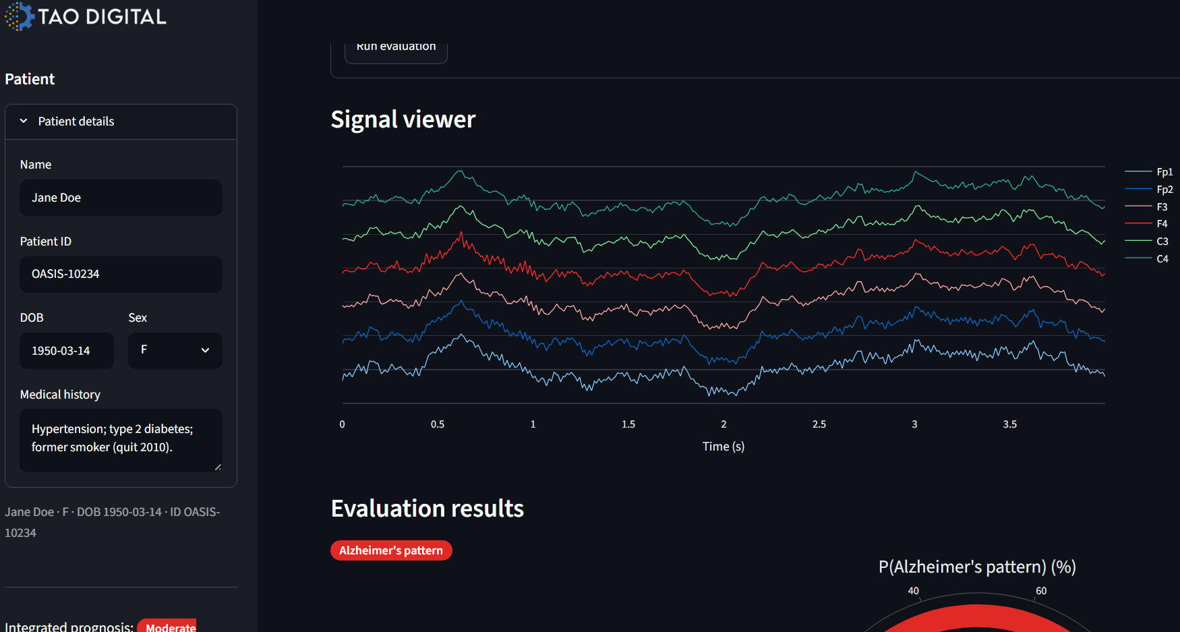
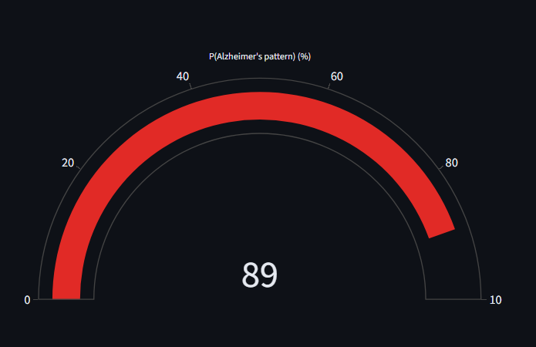
User journey
Notes:
Let's start with the most common patient scenario: a missed dose.
>
> I'll tap the quick-message button -- these are care-plan-specific pre-built messages, pulled directly from the epilepsy JSON. They cover the typical reasons a patient opens the app.
>
> Watch what happens when the message submits. The first thing the system does is run **safety triage** -- a deterministic, regex-based classifier that operates with zero LLM involvement. It does not need an API key. It does not need a network connection.
>
> Here is the result: a **FLAG badge** in yellow. That means the triage engine detected a missed-dose pattern and set `hcp_alert = True`. The prescribed patient actions appear immediately -- 'Contact your neurologist before taking extra medication. Do NOT double your dose.'
>
> Below that is the LLM reply: empathetic, concise, grounded in Keppra specifically -- not generic advice. Notice the triage level is confirmed in the LLM output. Even if the model wanted to say 'it's probably fine, wait and see', it cannot -- the triage level is injected as a hard system constraint the model must echo.
>
> At the bottom of the page, a warning banner confirms: 'FLAG -- Care team notified of missed dose.'"

Slide 15
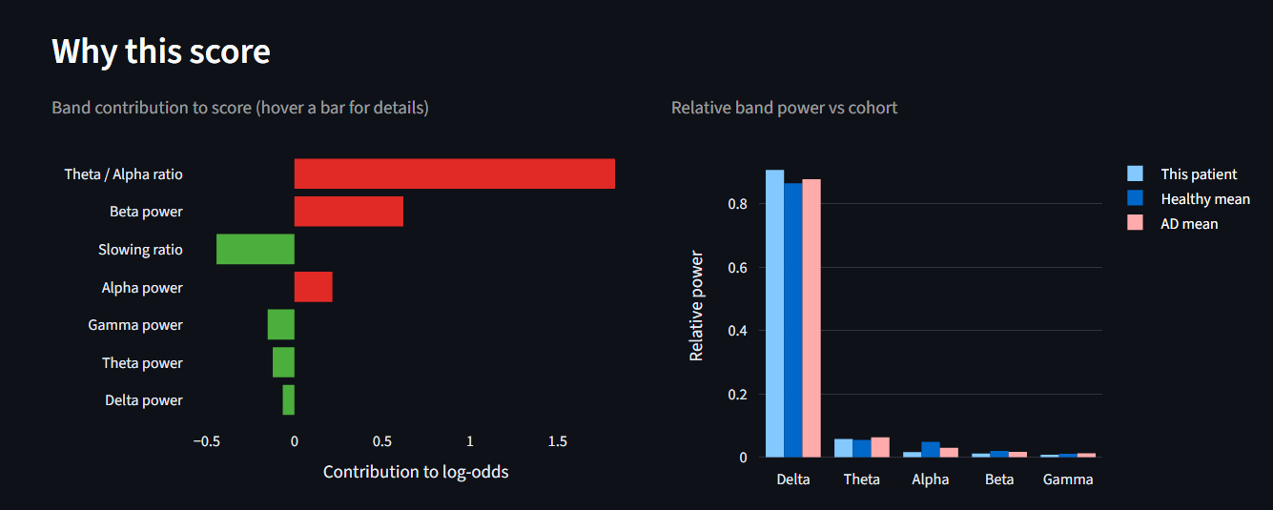
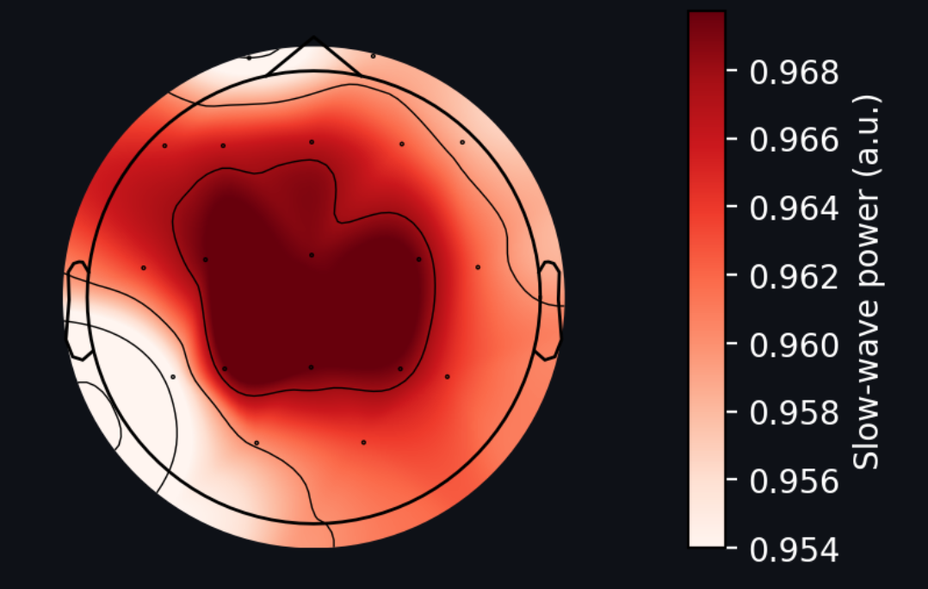

Slide 16
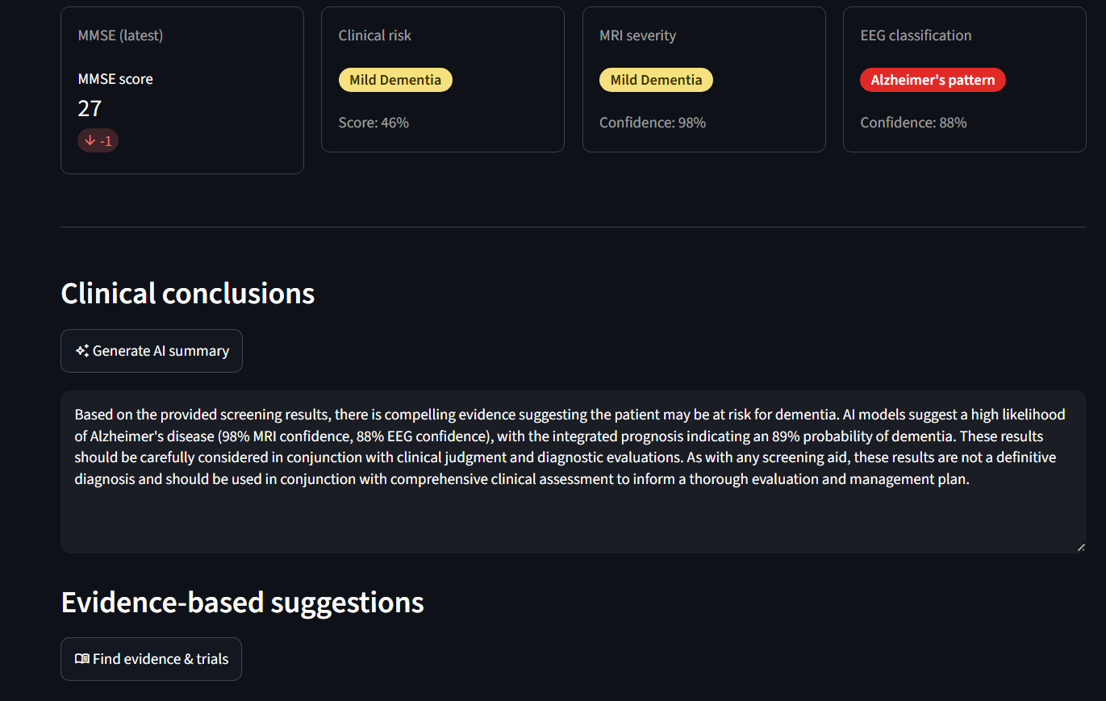

Slide 17
Results
Model | Algorithm | Accuracy | AUROC | AUPRC | F1 | Sensitivity | Specificity
Clinical | Logistic regression (9 features) | 0.7 | 0.73 | 0.64 | 0.55 | 0.47 | 0.84
MRI (Non Demented vs Demented) - preliminary | ResNet18 (frozen backbone | 0.81 | 0.91 | 0.89 | 0.78 | 0.7 | 0.91
EEG | Logistic regression on band-power features | 0.75 | 0.82 | 0.83 | 0.77 | 0.75 | 0.76
*metrics will change once we get approval from larger datasets.
Notes:
Six data assets power this system. Let me walk through what each one does and why it was built the way it was.
>
> The epilepsy care plan JSON is the clinical constitution for the LLM. It encodes levetiracetam and lamotrigine dosing, the HCP contact, and the quick-reply templates the UI exposes. When the LLM generates a check-in reply, it is working inside the boundaries this file defines -- it cannot invent a dose, contradict a schedule, or recommend something the care plan does not authorize.
>
> The synthetic patient panel is the training data for the T-learner. Five hundred patients, 100 per intervention arm. The important design decision here is that the ground-truth treatment effects are hand-coded into the data-generating function -- HCP check-in uplift scales with side-effect score, reminder-call uplift scales with non-adherence and low engagement. This is intentional: it gives us a known answer to check the model against. We are not hoping the T-learner finds a signal; we built the signal in and can verify the model recovers it.
>
> The DuckDB adherence log is the real-time data layer. Every dose event -- taken or missed, medication, timestamp -- is stored here. In this POC it is seeded at startup with 28 days of synthetic history at roughly 85% adherence. In production, this table would be replaced by an OMOP CDM or a live FHIR feed from an EHR. The rest of the pipeline does not need to change.
>
> The Qini backtest data comes from running the T-learner on a separate 500-patient holdout -- not the training set -- and scoring the ranked contact curve against random. This is where the 0.35 versus 0.08 AUUC result comes from.
>
> The Cleanlab audit is a data quality check on the synthetic panel itself. Label noise is a known risk in stochastic data generators: an outcome might be recorded as zero for a patient whose features strongly predict a positive response. Cleanlab finds those rows using cross-validated random forest probabilities. The audit confirmed that label noise is within expected bounds -- so the T-learner is not fighting corrupted training signal.

Slide 18
Cost
Component | Cost per patient | Detail
MRI vision findings (HuggingFace Inference Providers, google/gemma-3-27b-it) | ~$0.0006 | ~300 prompt tokens + 1 image (256 tokens/crop, Gemma 3's fixed vision-encoder output) + ~120 output tokens
Clinical summary (Groq, llama-3.1-8b-instant) | ~$0.00004 | ~400 input / ~150 output tokens
Evidence & recommendations (Groq, llama-3.1-8b-instant) | ~$0.00005 | ~700 input / ~200 output tokens
PubMed / ClinicalTrials.gov retrieval | 0 | Free public APIs (esearch/esummary, ClinicalTrials.gov v2)
Expected results and impact
Total LLM inference cost: ~$0.00014 per patient case (published rates × actual prompt/response sizes: Groq $0.05/$0.08 per 1M in/out tokens, HF-routed Gemma 3 27B $0.08/$0.16 per 1M in/out tokens). The real cost lever is imaging volume, which this tool is designed to reduce by triaging who really needs an MRI.
Notes:
The only variable runtime cost is the Step 5 LLM call. Steps 1 through 4 are pure Python with no paid API calls.
At 100 runs per month -- typical for a team managing multiple trials -- LLM cost ranges from under two cents on Groq to $1.80 on Claude Sonnet.
All four supported providers stay well under $2 per month.

Slide 19
Conclusion / Key Takeaways
For patients: Turns routine clinical data into an explainable early-risk signal ahead of costly imaging, targeting the client's imaging-cost and late-detection pain points directly.
For clinicians: every score arrives with its top reasons in plain language, plus an MRI second opinion and an EEG third opinion when needed, so a clinician is never asked to act on a number they can't interrogate.
For clinicians: an AI layer drafts the case summary, translates MRI findings into plain language, answers follow-up questions about the case, and pulls cited supporting evidence, so it removes the busywork around a decision without ever making the decision for them.
Notes:
Let me close with the key takeaways.
>
> First, this system is safe by design -- not by prompt. Triage is deterministic and the LLM operates inside a hard constraint. That is the correct architecture for clinical AI.
>
> Second, the agent is genuinely causal. It does not ask 'who should we contact?' -- it asks 'what changes this patient's behavior, and does it change it enough to justify contact?' The explicit 'no contact' recommendation is as important as any positive recommendation.
>
> Third, we have evidence the targeting works. The Qini backtest is not a theoretical claim -- it is a reproducible validation on a holdout set.

Slide 20
Thank You

